Slide 1

YTÜ Department of Bioengineering
Internship Information Presentation
23 April 2026

Slide 2
Industrial Relations and Internship Commisions
2025-2026 Academic Year
Prof. Dr. Serap Acar DERMAN (Head)
Prof. Dr. Ayhan BİNGÖLBALİ (Member)
Assos. Prof. Dr. Azime ERARSLAN (Member)
Res. Assist. Dr. Cem ÖZEL
Res. Assist. Dr. Ayça ASLAN ARAS
Res. Assist. Gülcan Ayşin KARACA
Res. Assist. Eda Nur YETİŞKİN MORKAN
Res. Assist. Selcan AKAR
Res. Assist. Elif Nur YILDIZ
Res. Assist. Zişan TOPRAK
Res. Assist. Ayça GÜVEN
Res. Assist. Erva Esma YILDIRIM UÇARKUŞ

Slide 3
Definition of Internship
Internships are practical training activities carried out in private or public workplaces in order to reinforce the theoretical and applied knowledge acquired during undergraduate education.

Slide 4
Purpose of the Internship
Within the framework of the Internship Principles specified in the YTÜ Undergraduate Education Internship Application Directive, and in line with the educational objectives and outcomes of the Department of Bioengineering, its purpose is to contribute to the academic and professional development of students through practical work in private or public institutions.

Slide 5
Purpose of The Internship
To help students improve their professional etiquette,
To increase their theoretical and practical experience regarding their profession,
To get to know the industrial environment and business life,
To build new business relationships,
To enable them to put the knowledge acquired during their undergraduate education into practice.

Slide 6
Internship Principles-1 :
Internships are intended to reinforce the theoretical and applied knowledge acquired in undergraduate education.
Internships can be carried out domestically or abroad.
In the Department of Bioengineering, students are required to complete a total of 2 (two) different internships—namely Laboratory Internship and Production Internship—each lasting 20 (twenty) working days, in order to increase their professional knowledge, skills, and experience. Mandatory internships are compulsory courses listed in the Department Curriculum as Internship 1 and Internship 2, which must be carried out within the framework of internship principles.
The internship duration is 20 working days separately for both internships. Internship processes are conducted separately for both internships. Internship documents and the internship notebook are filled out separately for both internships.
Students must start their internships after taking second-year courses in order to benefit effectively from the internship.
Mandatory internships can be carried out during academic breaks.
Taking into account the student's course and exam schedule for the relevant semester, internships can be carried out on days when they have no classes/exams, for at least 3 full working days per week (including Saturdays if the institution works on Saturdays). Internships may also be carried out outside the education-training and exam period.

Slide 7
Internship Principles-2 :
The responsibility of finding an internship place fundamentally belongs to the student.
Students can do their Laboratory Internships starting from the beginning of the academic break after the first four semesters.
Students can do their Production Internships starting from the beginning of the academic break after the first six semesters. However, students must complete their Laboratory Internships before they can do their Production Internships.
Mandatory and Optional Internships can be divided into a maximum of two parts, provided that the internship duration is not less than 10 working days. In case of division, internship documents and the internship notebook must be filled out separately for both internships.
Graduation Projects will not be taken into account in this determination.

Slide 8
Internship Principles-3 :
Students who have completed their 6th semester or have passed all courses in their program, and who have no classes or exams before 18:00 on at least three free full working days including Saturday, may do an internship concurrently with education. Graduation Projects will not be taken into account in this determination.
Students cannot change the internship place approved by the internship commission without a valid reason acceptable to the commission.

Slide 9
Internship Principles-4 :
Official holidays are not accepted as internship duration (except abroad).
A week is considered as five working days.
For internships done on Saturdays, a document proving Saturday work (obtained from the company) must be attached to the documents. The internship on Saturday must be a full day, not a half day.
Students who will do internships on weekdays during the academic semester must also bring their course schedules along with the documents to be submitted to the deanship insurance unit.

Slide 10
Internship Principles-5 :
Students who take leave or medical reports for any reason during the internship must immediately report this situation to the school internship commission. If the notification is delayed, heavy fines are imposed on the school by SSI (SGK). The internship of students in this situation must be extended by the number of days they were on report.
If the internship is done abroad, there must be a social security agreement between the country in question and SSI. These countries can be found on the SSI website. If there is no agreement, the internship is accepted, but the student cannot receive a salary or benefit from SSI.
Students may do internships abroad in workplaces related to their departments, either through the ERASMUS Program or by their own means during the semester or summer vacation, with the favorable opinion of the relevant Department Internship Commission, the proposal of the Department Chair, and the decision of the Faculty Board of Directors. Commission approval is required.
Students whose internship within the scope of the ERASMUS+ Program is accepted are required to do an internship for at least 60 working days. Internships carried out within the scope of the ERASMUS+ Program are completed with the approval of the Erasmus Commission and the Internship Commission.

Slide 11
Abroad Internship
Students who want to do internships abroad must comply with the above-mentioned matters in the same manner. Depending on the institution where they will do their internship abroad, they can complete their documents in accordance with one of the following options. Internship documents can be filled out in Turkish or English. In this case, the English forms available at www.kalite.yildiz.edu.tr must be filled out.
Students who want to do their Mandatory Internships (Laboratory and Production internships) abroad must prepare their forms in English (forms numbered FR-1877, FR-0734, and FR-0735 on the quality website) and Turkish.

Slide 12
Other Internship
Other Internships (Optional/Voluntary Internship): Non-mandatory (voluntary) internship is an internship that is not compulsory in the curriculum and is done upon the student's request. It can be carried out from the end of the 4th semester throughout the entire education period (3 free working days) and during academic breaks.
The completion of other internships is not a prerequisite for doing a voluntary internship.
Mandatory internship criteria also apply to voluntary internships.
For a voluntary internship, the student must submit a petition to the department. If the petition is approved by the internship commission and the Faculty Board of Directors, insurance entry will be made, and the student can carry out their voluntary internship.
The Faculty Board, upon the recommendation of the Department Head, is authorized to grant exemptions to students for internships completed at previous higher education institutions, provided they have the necessary documentation. Decisions of the Faculty Board regarding these exemptions are communicated to the Student Affairs Office. Students in this situation are required to obtain their internship documents from the relevant higher education institution within their first semester of enrollment. Students who fail to submit their internship documents within the specified semester will have their internship exemption requests rejected.

Slide 13
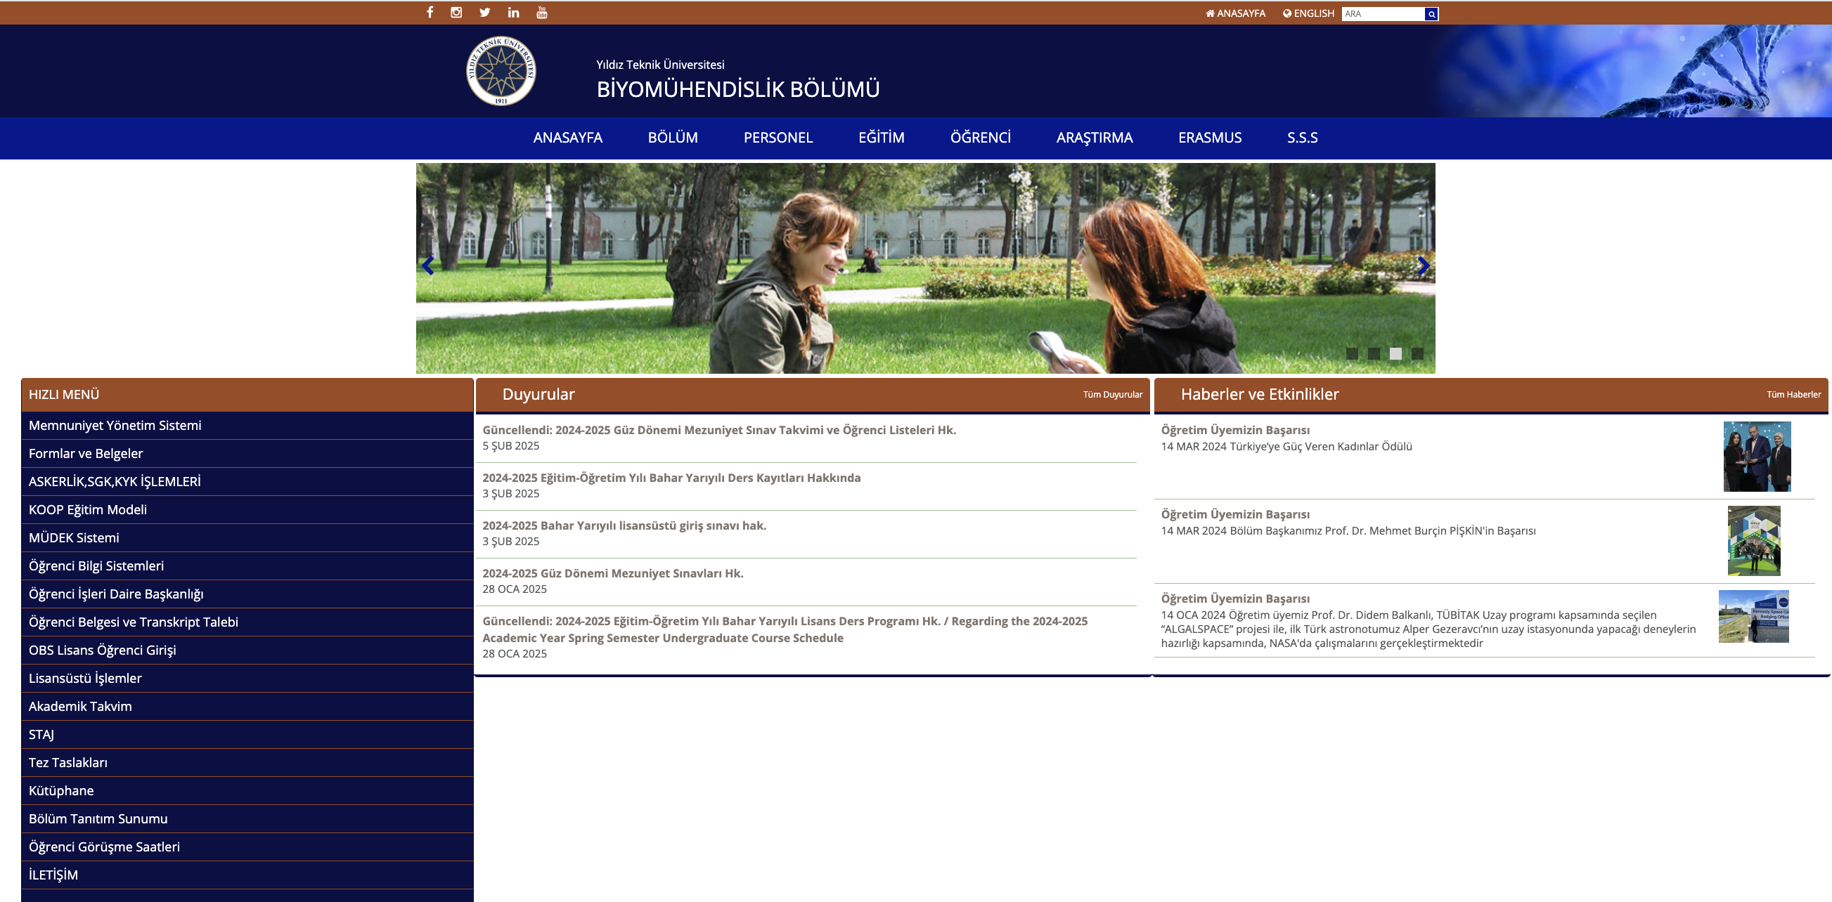
Internship Principles-6 :
Forms related to internships are provided under the Internship tab on the Department's website [https://bioeng.yildiz.edu.tr/sayfa/17/STAJ/64] and via the YTÜ Quality Coordinator's website.

Slide 14
Duties of the Internship Commission
To carry out the coordination and evaluation of the internship,
To determine the work program and principles of the internship, and to ensure that students do their internships in accordance with program objectives and outcomes,
To guide students regarding internship locations,
To evaluate internships by administering surveys and examining internship notebooks,
To control and monitor the internship by calling or visiting randomly selected internship locations,
To send e-mails to other universities/departments, alumni regarding the Promotion of the Department and Internship Place Needs,
To handle correspondence related to internships coming from companies (e.g., e-mails).

Slide 15

1877 YTÜ Internship Application Form (Internship Application Form)
286 numbered Internship Record Form (revised version)
729 numbered Trainee's Institution Evaluation Survey
730 numbered Trainee Evaluation Survey
SSI SPAS Eligibility Certificate obtained from e-Government
Internship Notebook PDF
3 photos
Calendar 2026

Slide 16
Internship Process-1 :
The company where the internship will be done is found, and approval is obtained verbally or via e-mail from the responsible faculty member of the relevant internship commission as to whether the company is suitable. (A list of some institutions where you can intern is available on the department internship page).
NOTE: While getting internship location approval, you should first contact the relevant research assistant via e-mail.
Depending on the Research Assistant's response, the document approval process should be initiated. After obtaining suitability for the internship place, printouts are taken from [http://www.kalite.yildiz.edu.tr](http://www.kalite.yildiz.edu.tr) or the Department Internship tab ([https://bioeng.yildiz.edu.tr/sayfa/17/STAJ/64] (YTÜ Internship Application Form, Internship Record Form, SSI SPAS Eligibility Certificate, Calendar, Surveys).
The YTÜ Internship Application Form is approved in 3 copies at the institution where the internship will take place, and other documents are filled out in single copies.
First, the fields, stamps, and signatures required to be filled out by the institution where the internship will take place must be completed, and then the relevant fields in the documents are filled out by the student. 1 copy of the YTÜ Internship Application Form will be taken to the internship institution, and 1 copy (original) will remain with the student and will be delivered to the relevant research assistant at the end of the internship along with the internship notebook and other documents.

Slide 17
Internship Process-2 :
The internship record form and surveys are signed by the department chair/vice chair. (These documents can also be signed at the end of the internship, but our recommendation is to prepare them before the internship along with other documents.)
Once all procedures, signature, and seal processes are completed, you must come to the department with the all documents, along with 3 photos, the internship notebook, and a copy of your ID. Approval and signature are obtained from the relevant Research Assistant responsible for internships in the department.
Photos on the YTÜ Internship Application Form, Internship Record Form, and internship notebook must be sealed and submitted at the faculty deanship unit. (Deanship 2nd floor, room A-222).
NOTE: Contact the relevant research assistant via e-mail to visit their office for document delivery approval.

Slide 18
Internship Process-3 :
The YTÜ Internship Application Form, SSI SPAS Eligibility Certificate obtained from e-Government, Internship Record Form, Unemployment Fund Contribution Information Form (not mandatory for government institutions), Calendar, and ID photocopy (6 documents) are submitted to the Faculty Insurance Unit (Deanship 2nd floor, room A-222, SSI Unit).
NOTE: The SSI start/end date must be the same as the internship start/end dates. If a difference in dates is detected, the internship will be considered invalid.
NOTE: Application to the school for internship insurance entry must be made from 1 month to 10 days before the start of the internship. (Applications cannot be made earlier than 1 month or later than 3 days - Note: text mentions 3 days or 10 days constraint for application window).

Slide 19
Internship Process-4 :
2-3 days before the start of the internship, the YTÜ Internship Application Form and Employment Entry Declaration (this document can also be obtained via e-government) are picked up from the Department Student Affairs.
Note: 1 copy of the YTÜ Internship Application Form will be taken to the internship institution, and 1 copy (original) will remain with the student and will be delivered to the relevant research assistant at the end of the internship along with the internship notebook and other documents.
The YTÜ Internship Application Form is delivered to the workplace on the day the internship starts. (1 copy (original or photocopy) will be brought for the department).

Slide 20
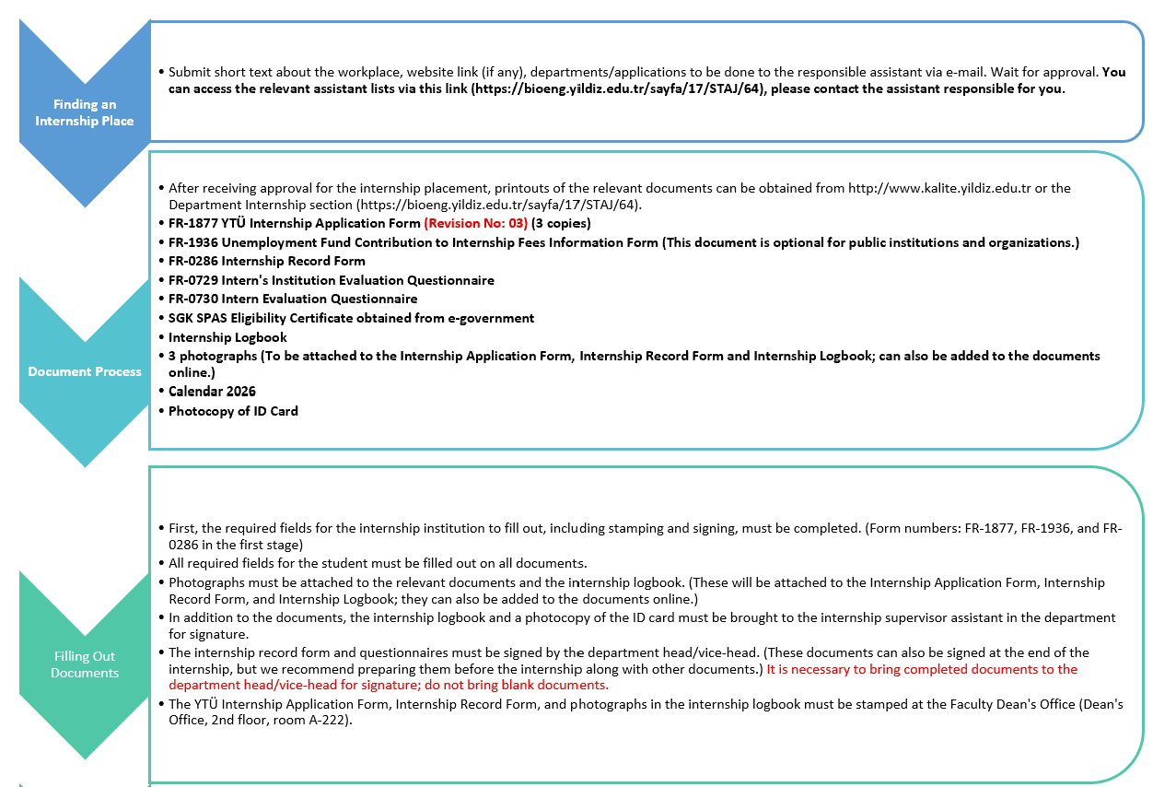

Slide 21
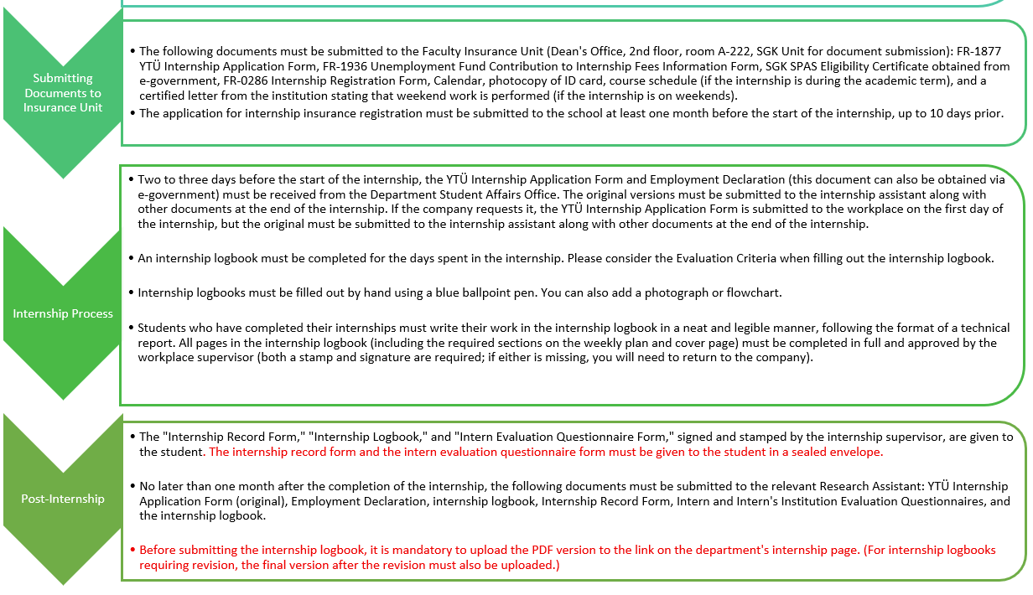

Slide 22
  The following documents, with their form numbers, can be downloaded from the department's website:
  YTÜ Internship Application Form
  SGK SPAS Eligibility Certificate obtained from e-government
  Calendar 2026
  Employer-Student Evaluation Questionnaires
  Internship Record Form
  Photocopy of ID (extra)
  3 Passport-sized Photographs (extra)
BEFORE INTERNSHIP
Has approval for the internship location been obtained from the responsible faculty member?
The chosen internship location must be approved by the internship committee. If the internship location does not meet the criteria, the internship will be cancelled.
YES
NO
YTU Internship Application Form
SGK SPAS Eligibility Certificate
Calendar
Photocopy of ID Card
Internship Logbook
To be submitted to the Dean's Office Insurance Unit for insurance procedures at least 10 days before the start date of the internship.
The YTÜ Internship Application Form, Internship Record Form, and internship logbook, along with photographs, must be stamped by the Faculty Dean's Secretary.
The YTÜ Internship Application Form must be signed and stamped by the authorized representative of the institution where the internship will be conducted. All necessary information must be filled out on the other documents.
The documents are checked and signed by the relevant internship supervisor.
The Internship Record Form and questionnaires are signed by the department head/assistant.

Slide 23
AFTER INTERNSHIP APPLICATION
The YTÜ Internship Application Form and the SGK Employment Declaration must be obtained from the Dean's Office Insurance Unit or the department's student affairs office 2-3 days before the start of the internship.
The YTÜ Internship Application Form must be submitted to the workplace on the day the internship begins.
The following documents must be submitted to the department's internship committee no later than one month after the completion of the internship:
Internship Logbook,
Internship Record Form,
YTÜ Internship Application Form,
Employment Declaration,
Employer-Student Evaluation Questionnaires.
A PDF version of your internship logbook can be uploaded to the link on the department's website.
INTERNSHIP EVALUATION

Slide 24
Internship Process-5 :
Submission of the internship logbook
The "Internship Record Form," "Internship Logbook," and "Intern Evaluation Questionnaire Form," signed and stamped by the authorized person at the internship location, are given to the student. The internship record form and the intern evaluation questionnaire form should be given to the student in a sealed envelope.
No later than one month after the completion of the internship, the YTÜ Internship Application Form (original), Employment Declaration, internship logbook, Internship Record Form, Intern and Institution Evaluation Questionnaires, and the internship logbook must be submitted to the relevant Research Assistant.
NOTE: You should contact the relevant research assistant via email to submit the documents and the internship logbook in their office.
NOTE: Internship locations not approved by the Industrial Relations and Internship Commission will not be accepted, and the commission will decide on any changes.
NOTE: The logbooks should be submitted to the responsible internship commission members during their respective student consultation hours that week, not at any specific time.

Slide 25
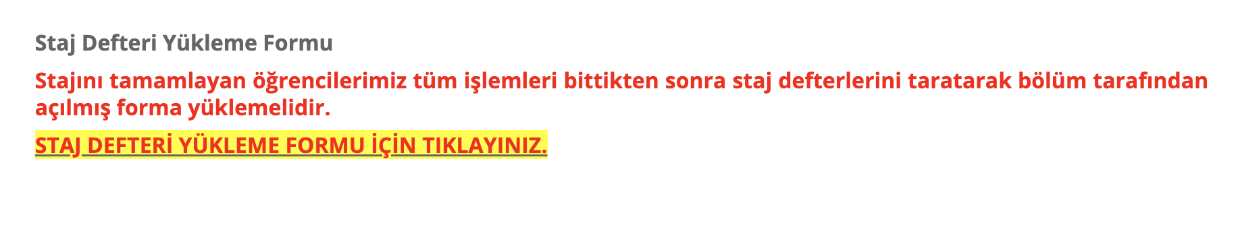
Internship Process-6 :
Submission of the internship logbook
The PDF form of the internship logbook must be uploaded to the link on the department's internship page before submission. (For internship logbooks requiring revision, the final version after the revision must also be uploaded.)

Slide 26
Laboratory Internship:
This is a practical training program that students undertake in the laboratory of an industrial manufacturing company, a healthcare facility, or an academic research and development laboratory.
Generally, laboratory internships include an introduction to the laboratory, familiarization with the tools and equipment used in the laboratory, methods of preparing samples for analysis, learning the analytical methods used in the laboratory, evaluating analysis results, and quality control procedures.

Slide 27
Production Internship:
It is done after the laboratory internship is completed.
"Production internship cannot be done without successfully completing the laboratory internship and entering it into the system."
These are practical studies that students will do in an industrial production company in a field related to Bioengineering to reinforce the knowledge they have gained from engineering courses they have taken in the first three years.
In addition to their professional observations within the framework of directly monitoring the development of production and business technology and identifying-defining-solving engineering problems, the aim is to develop awareness of health, safety, environment, ethics and quality, individual work skills, establishing and maintaining social relationships and lifelong learning awareness.

Slide 28
Production Internship:
Topics that this internship may cover include the company's purpose, process flow diagrams and material and energy balance within the company, mass and energy transfer systems, production (reactor) systems and process control systems used in the company, and waste control and treatment systems.
Production internships cannot be done in R&D and quality control units.

Slide 29
Completing the Internship Logbook - Part 1
Students who have completed their internships must write their work in their internship logbook in a neat and legible manner, following the format of a technical report. All pages in the internship logbook must be filled out completely and approved by the workplace supervisor (a stamp and signature are required; if either is missing, the company must be contacted again).
If the pages of the internship logbook are insufficient, additional writing paper of the same size can be added to increase the number of pages, or a second internship logbook can be used if the number of pages is too high.
Subjective language should not be used; objective language should be employed. Internship logbooks must be filled out by hand with a blue ballpoint pen.
Students who have completed their internships must write their work in their internship logbook in a neat and legible manner, following the format of a technical report. All pages in the internship logbook (including the weekly plan and the required sections on the cover page) must be filled out completely and approved by the workplace supervisor (a stamp and signature are required; if either is missing, the company must be contacted again).

Slide 30
Completing the Internship Logbook - Part 2
No changes, erasures, or alterations will be made to the sections where dates are written in the internship logbooks.
The language to be used in writing the internship logbook is Turkish for Biomedical Engineering students (30% English), and English for 100% English students. Biomedical Engineering students (30% English) who complete their internship abroad may write their logbook in English.

Slide 31
Completing the Internship Logbook - Part 3
The internship report must be submitted within a maximum of one month after the internship ends.
Internship reports submitted by students exceeding the specified deadline will be accepted only if the student has a valid and documented excuse (e.g., a medical report). The relevant research assistant must be informed in advance.
Note: If the internship report is deemed insufficient during the evaluation process at the end of the internship, revision or repetition of the internship may be requested.

Slide 32
Completing the Internship Logbook - Part 4
In addition to the work done during the internship, the intern will also provide information about the location and organization of the institution where the internship is taking place (work, time and method research, purchasing, personnel, planning, accounting departments).
For production internships, it is necessary to fill in the information requested in the evaluation criteria, such as mass calculations, heat-mass transfer equations, production flowchart, cost analysis, and information related to production and bioreactors.
When filling out the internship logbook, the analysis of experimental results for the examination of complex engineering problems or discipline-specific research topics should also be mentioned, along with data, graphs, tables, images, and interpretations of the results analysis.
The internship logbook should also include information about the intern's approach to Quality and Standards, health, safety, environment, ethics, and quality awareness.

Slide 33
Evaluation of the Laboratory Internship Logbook - 1
Internship reports are evaluated by the Department's Industrial Relations and Internship Committee.
Evaluation of the Laboratory Internship Logbook | Point
General information about the institution where the internship is completed, the laboratory organizational chart, and its place within the institutional organizational chart. | 20
Introduction of the devices and tools used during the internship. | 15
Explanation of analytical methods used in the laboratory, evaluation of analytical results, and application of statistical methods. | 25
Examining whether the analyses performed in the laboratory have one of the quality control system practices. | 10
Review of the work carried out in the Research and Development Department. | 10
The internship logbook must comply with the writing rules specified in the Department's internship guidelines. | 20
TOTAL POINTS | 100

Slide 34
Evaluation of the Production Internship Logbook - 1
Evaluation of the Production Internship Logbook | Point
General information about the institution where the internship is taking place, the institution's organizational chart, and the facility's layout plan | 15
The purpose of the operation is to create process flow diagrams at the facility | 15
Examination of process equipment used in the facility, classified for the following purposes: … Material handling, processing, separation, storage … Heat transfer … Mass transfer … Production (Reactors) … Process control … Waste control and treatment | 20
Investigation of the fundamental processes and reactions in the process(es) applied at the facility, establishment of material/energy balances for the process, and economic analysis. | 20
Examining the approach of bioengineers to issues related to health, safety, environment, ethics, and quality awareness. | 10
The internship logbook must comply with the writing guidelines for internship logbooks. | 20
TOTAL POINTS | 100

Slide 35
Internship Logbook Evaluation-2
Interns whose internships are evaluated and deemed successful by the Industrial Relations and Internship Commission can view their internship approval results through their OBS system.
Members of the Internship Commission review the internship documents sent to them by the Department Head within a maximum of one month, in accordance with the faculty and department's "Internship Guidelines," and may request corrections or reject them. Accepted internships are reported in writing to the department head by the commission chairman..

Slide 36
Internship Logbook Evaluation-3
If the internship report is deemed insufficient during the evaluation at the end of the internship, a revision or repetition of the internship may be requested.
Students requesting corrections must make the requested corrections within a maximum of one month; otherwise, it will be considered rejected, and the Department Head will be notified in writing at the end of this period.
In cases other than those explained above, the faculty administrative boards are authorized to evaluate internship documents and to grant exemptions from internships. Accepted internship reports are kept in a location allocated by the Department Head for at least two years, starting from the date of acceptance.
Internship reports whose storage period has expired are destroyed in a manner deemed appropriate by the relevant Department Head.

Slide 37
Internship Logbook Evaluation-4
Students whose internship applications are rejected will be notified in writing of the rejection reason through the Department Head. Students whose internships are deemed unsuccessful and rejected must complete the internship again.
Students whose internship applications are rejected may appeal to the relevant Department Head within one week of receiving written notification. The internship file will be re-examined by the relevant Department Head to determine if an error was made, and the decision will be finalized by the Faculty Board.

Slide 38
Other Provisions
Students with internship obligations cannot graduate until they complete their internships. The provisions of the Higher Education Institutions Student Disciplinary Regulations also apply during internships.
The university is not responsible for any damages caused by interns to the institutions where they are interning due to their faults.

Slide 39

GOOD LUCK ☺

